Slide 1
CSG PRODUCED WATER TREATMENT BY RO & NANOFILTRATION
DESIGN CREDIT UNDER
VIKKY ANAND

Slide 2
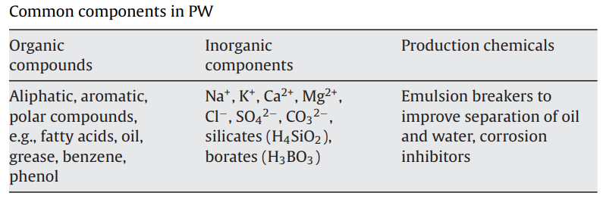
INTRODUCTION
Coal Seam Gas (CSG) production is essential for energy needs, but it comes with challenges, notably produced water.
Economical and environmentally friendly methods of disposal of PWs are vital in order to prevent serious environmental damage.
Conventional treatment of PWs has included gravity separation and skimming, dissolved air flotation, de-emulsification, coagulation and flocculation.
Composition of produced water .

Slide 3
ADVANTAGE OF USING MEMBRANE FILTRATION PROCESS.
The technology is more widely applicable across a range of industries (e.g., off shore and on shore oil exploration)
The membrane is a positive barrier to rejected components, thus the variation in feed water quality will have a minimal impact on permeate quality.
No addition of chemicals is required.
Membranes can be used in process to allow recycling of selected waste streams.
Membrane equipment has a smaller footprint, energy costs are often lower and the plant can be highly automated.
Focus is on the use of polymeric nanofiltration and low-pressure reverse osmosis thin film composite (TFC) membranes for treatment of PWs.

Slide 4
Produced Water Characteristics
CSG produced water is a complex mixture with various contaminants
Salts: Dissolved ions like sodium, chloride, and sulfate.
Hydrocarbons: Organic compounds released during gas extraction.
Heavy Metals: Elements like arsenic, mercury, and lead.
Suspended Solids: Particles from the formation and extraction process.

Slide 5
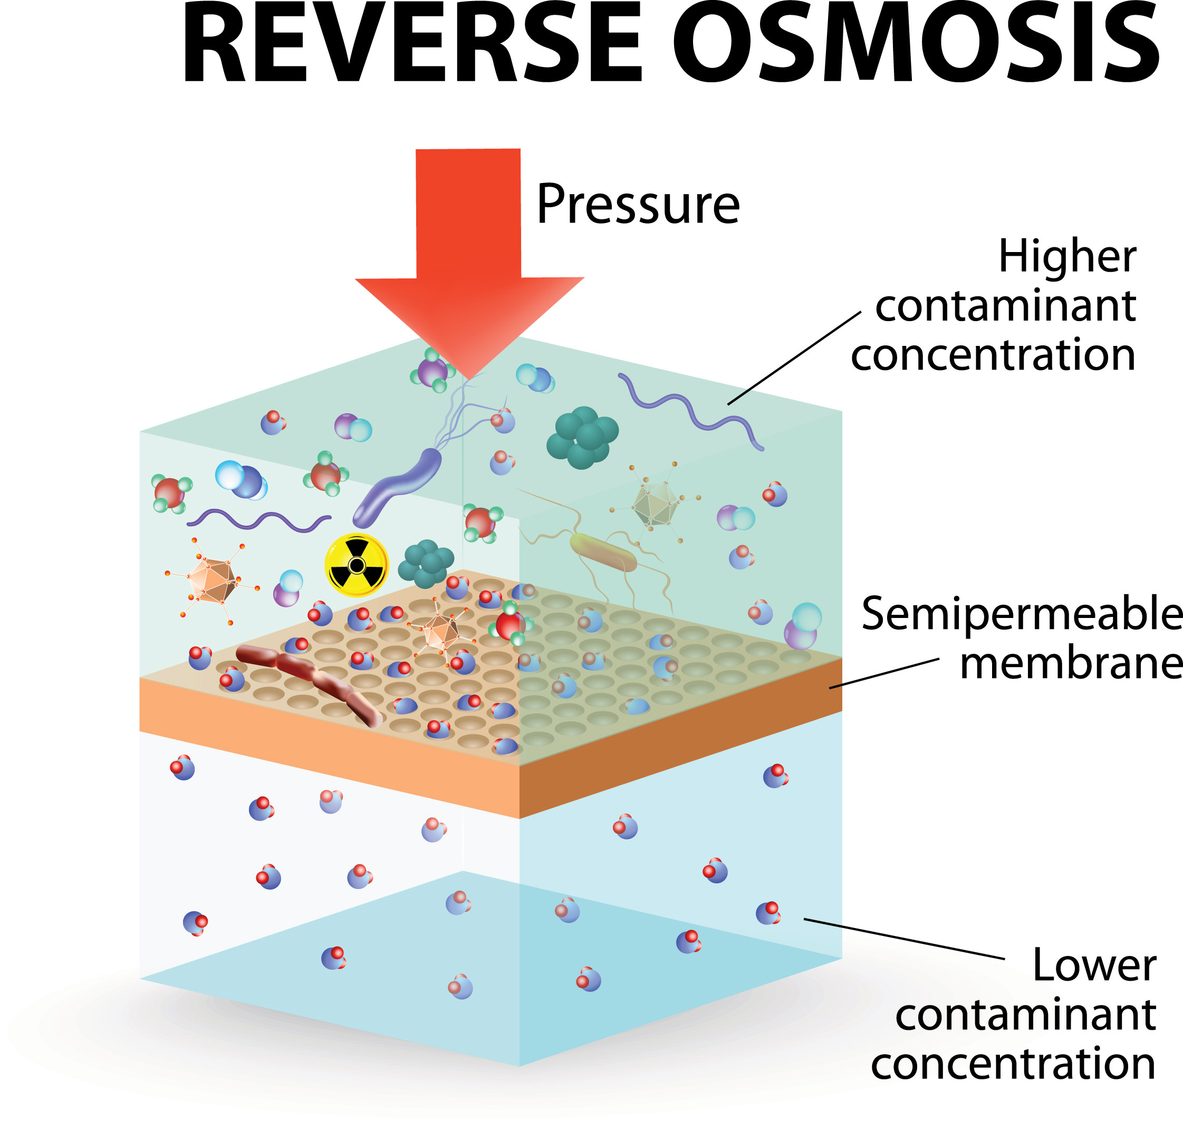
RO PROCESS FOR PW’S
WHAT IS RO=REVERSE OSMOSIS.
Reverse osmosis (RO) is a water purification process that utilizes a semi-permeable membrane to remove impurities and contaminants from water.
Reverse Osmosis (RO) for Produced Water Treatment
RO is a membrane-based separation process:
Semi-permeable membrane allows water molecules to pass while blocking impurities.
Applied pressure forces water through the membrane, leaving contaminants behind.
Effectively removes dissolved salts, organic compounds, and larger particles.
RO Process for CSG Produced Water
RO treatment involves two main stages:
Pretreatment: Filtration to remove larger particles, oils, and organic matter.
Membrane Separation: RO membrane selectively allows water molecules to pass, rejecting salts and impurities.

Slide 6
NANOFILTRATION FOR PW’S
Nanofiltration is a water purification process that falls between ultrafiltration and reverse osmosis in terms of filtration capabilities. It utilizes specialized membranes with nanopores to selectively separate water molecules from ions and larger molecules, effectively removing a wide range of contaminants such as salts, organic compounds, and some divalent ions
Nanofiltration for Produced Water Treatment
Nanofiltration is similar to RO but operates with larger pores:
Allows monovalent ions to pass through, retaining divalent ions and larger molecules.
Effective in removing hardness, color, and disinfection byproducts.
Nanofiltration for Produced Water Treatment
Nanofiltration is similar to RO but operates with larger pores:
Allows monovalent ions to pass through, retaining divalent ions and larger molecules.
Effective in removing hardness, color, and disinfection byproducts.

Slide 7
Benefits of RO and Nanofiltration for CSG Produced Water
Advantages of using RO and Nanofiltration:
High removal efficiency of dissolved solids and contaminants.
Reduced environmental impact through cleaner effluent production.
Potential for treated water reuse in various applications.

Slide 8
Challenges and Considerations
RO and Nanofiltration systems face challenges:
Membrane fouling: Accumulation of impurities on the membrane surface.
Scaling: Precipitation of salts on the membrane.
Energy consumption and operational costs.
Maintenance and monitoring for consistent performance.

Slide 9
THANKS

